Slide 1


Accelerating AI/ML Research with AWS
Aditya Challa, Bill Snyder, Jack Fenwick, Jianjun Xu, Sudheer Manubolu
April 2, 2025 / AWS Tools Showcase
AI Workshop Denver, CO April 2-3, 2025

Slide 2

[PLACEHOLDER - AWS Names/Bios]

Slide 3
AWS Credits for full range of AWS Services
650+ publicly available datasets
350+ built-in algorithms & pre-trained models and 100+ public & proprietary foundation models in Amazon Bedrock
Project support from NSF CloudBank and AWS
On-demand training
AWS resources for NAIRR researchers
Notes:
AWS Credits and Resources: Project credit amounts will depend on scope and researching needs. We will evaluate all resource requests for technical suitability, AWS Service and infrastructure requirements, and resource availability.
AWS provides access to 850 generally-available compute (EC2) instance types, many optimized for AI, ML, and high-performance computing
AWS provides access to public and customizable pre-trained models through Amazon SageMaker and leading foundation models (FMs) through Amazon Bedrock.
More on this in next slide
Registry of Open Data: Researchers can access more than 500 datasets through our Registry of Open Data, many of which are optimized for use in machine learning. These rich datasets, many optimized for machine learning services, include high-impact datasets in astronomy, climate science, genomics and metabolomics, agriculture, and machine learning. These datasets are accessible and relevant for virtually every focus area of the current NAIRR Pilot CfP.
ML Models: pre-trained machine learning (ML) models, including foundation models for GenAI through Amazon Bedrock and Amazon SageMaker.
CloudBank and AWS Support: To remove administrative burden for PIs, AWS is partnering with CloudBank who provide front-line help desk support, training, and cost monitoring & automated billing. PIs will also have access to AWS solutions architects who can assist in architectures and services best suited for your project
Training: AWS SkillBuilder, Research Learning Pathway, Machine Learning Path – Access to the same machine learning courses used to train Amazon’s own developers on ML. Learn at your own pace MLU Accelerator with three, 3-day foundational courses on NLP, Tabular Data, and Computer Vision.

Slide 4
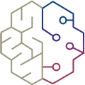



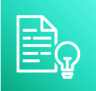

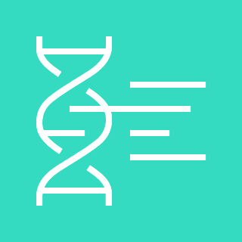
AI to drive research & innovation
Data analysis & pattern recognition:
analyze massive datasets to uncover hidden patterns
Natural language processing:
analyze text, summarize papers, detect sentiment
AWS services:
Amazon Bedrock
Amazon SageMaker
Computer vision:
analyze medical images, microscopy, environmental data
Amazon Rekognition
Amazon Comprehend
Physics Modelling:
speed up complex simulations - learning patterns and approximating solutions
Drug discovery:
AI predicts drug interactions and designs new candidates Robotics & lab automation
AWS HealthLake
AWS HealthOmics
Notes:
Note: highlight some of the use cases and AWS Services. Select from the text the partner examples you want to use. Add local examples if helpful. Customer examples in the Appendix.
University Research and Innovation – Stakeholder VP Research, Lead Researcher – Target: optimize the daily work of a research organization and optimize the lifecycle of a research project
Generative AI can significantly enhance research by automating data analysis, generating hypotheses, and creating simulations. It can process vast amounts of data quickly, identifying patterns and insights that might be missed by humans. Additionally, it can generate realistic synthetic data for experiments, reducing the need for costly and time-consuming data collection. Generative AI also aids in drafting research papers, creating visualizations, and translating complex data into understandable formats. By accelerating these processes, researchers can focus more on innovative thinking and less on repetitive tasks, ultimately speeding up scientific discovery.
AWS Services:
Amazon Bedrock: Managed platform for building and deploying large language models.
Amazon SageMaker: Comprehensive ML service for fast model development, training, and deployment.
Amazon Rekognition: Computer vision service for image and video analysis in applications.
Amazon Comprehend: NLP service using ML to extract insights from text.
AWS HealthLake: HIPAA-eligible service for healthcare data storage, transformation, and querying.
AWS HealthOmics: Suite of genomics and health data services.
AWS RoboMaker: Simplifies robotics application development, testing, and deployment.

Slide 5
The AWS AI/ML Stack
AI SERVICES
Generative
AI
SCALING GENERATIVE AI
Amazon Bedrock
USER EXPERIENCE
Amazon Q Business Amazon Q Developer Amazon Q in Connect Amazon Q in QuickSight
Specialized
AI Services
BUSINESS PROCESSES
Amazon Personalize
Amazon Forecast
Amazon Fraud Detector
Amazon Lookout for Metrics
SEARCH
Amazon Kendra
CONVERSATION
Amazon Lex
Contact Lens
Voice ID
Amazon Transcribe Call Analytics
CODE + DEVOPS
Amazon CodeGuru
Amazon CodeWhisperer
Amazon DevOps Guru
INDUSTRIAL
Amazon Monitron
Amazon Lookout for Equipment
Amazon Lookout for Vision
HEALTH
Amazon HealthLake
Amazon Comprehend Medical
Amazon Transcribe Medical
Amazon Omics
Consumer
Core
TEXT
Amazon Translate Amazon Comprehend
SPEECH
Amazon Polly Amazon Transcribe
VISION
Amazon Textract Amazon Rekognition AWS Panorama
AMAZON SAGEMAKER
STUDIO IDE
Tuner
JUMPSTART
Use pre-built models in SageMaker
CANVAS
No-code ML for business analysts
STUDIO LAB
Learn ML
GROUND TRUTH
Label data
Prepare data
Geospatial ML
Build with
notebooks
Train models
Deploy in production
Store features
Tune parameters
Manage and monitor
CI/CD | GOVERNANCE | RESPONSIBLE ML
ML FRAMEWORKS & INFRASTRUCTURE
Provider
PyTorch, TensorFlow
Amazon EC2
CPUs
GPUs
AWS Inferentia
AWS Trainium
Habana Gaudi
FPGA

Slide 6








GPUs and accelerators
P4d
P4de
P5
P5e
P5en
Comprehensive, secure, price-performant infrastructure for
NVIDIA A100-40GB
NVIDIA A100-80GB
NVIDIA H100
NVIDIA H200
NVIDIA H200
G5
G6
G6e
Trn1
Trn2
AI Workloads
NVIDIA A10G
NVIDIA L4
NVIDIA L40s
AWS Trainium
AWS Trainium2
Inf1
Inf2
DL1
DL2q
AWS Inferentia
AWS Inferentia2
Intel Gaudi 1
Qualcomm
AI100

Slide 7



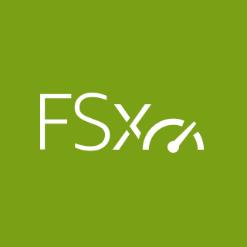
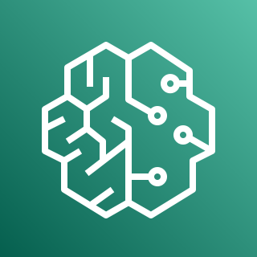
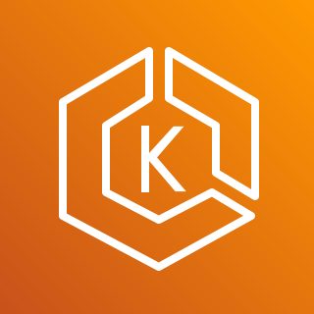



Storage & managed services for AI/ML apps
Storage services
Amazon EBS
Amazon EC2 local storage
Amazon S3
Amazon FSx for Lustre
Managed
services
Amazon
SageMaker
Amazon ECS
AWS
ParallelCluster
Amazon EKS
AWS Batch

Slide 8
NEW
Collaborate and build faster with a single data and AI development environment
Develop and scale AI use cases with the broadest set of tools
Reduce data silos with an open lakehouse to unify all your data
Meet your enterprise security needs built-in data and AI governance
Notes:
With the next generation of SageMaker, you have a unified platform for data, analytics, and AI.
You can collaborate and build faster from a unified studio using familiar AWS tools for model development, generative AI, data processing, and SQL analytics, accelerated by Amazon Q Developer, the most capable generative AI assistant for software development.
You can reduce data silos with an open lakehouse. Now you can access all your data whether it’s stored in data lakes, data warehouses, third party or federated data sources.
Governance is built-in end to end for your data and AI initiatives, to help you meet enterprise security needs.

Slide 9

Amazon SageMaker
Amazon SageMaker Unified Studio (preview)
Data Processing
SQL Analytics
Model Development
Gen AI APP Development
Streaming
Search
Business Intelligence
coming soon
coming soon
coming soon
Data & AI Governance

Slide 10

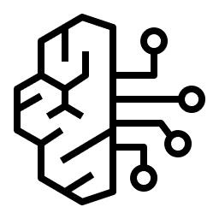

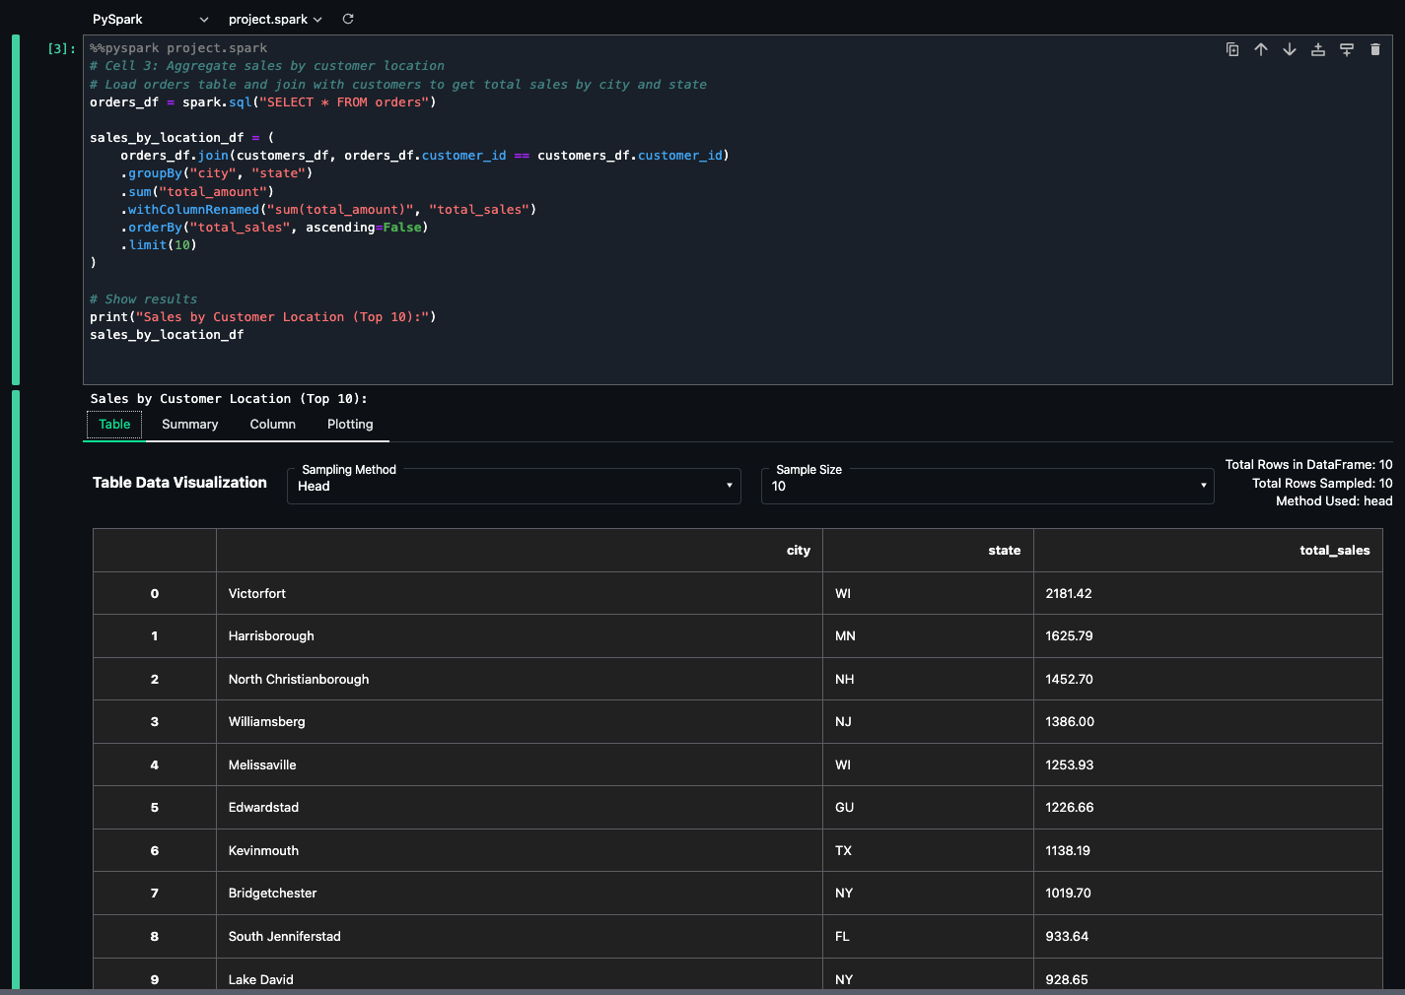
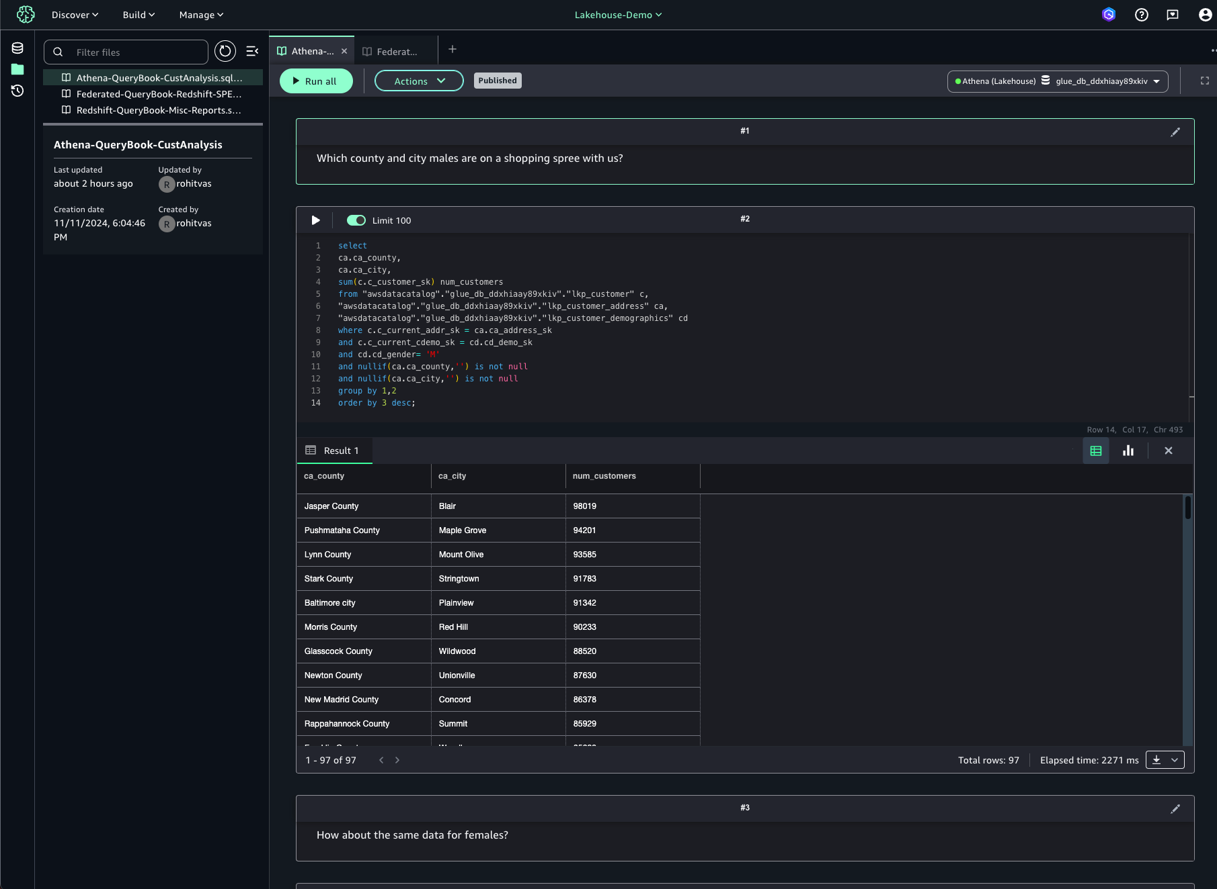
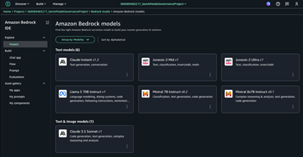
Seamless access to all data, all resources, and all tools
DATA
CODE
MODELS
COMPUTE
Lakehouse
JUPYTER NOTEBOOKS
SQL EDITOR
BEDROCK IDE (preview)
Notes:
Customers today are familiar with SQL Query Editor in Redshift or Athena, the Juypter notebook experience in Glue Studio and EMR Studio and the existing SageMaker Studio.
This tooling is now unified in the Amazon SageMaker platform,
where you have one consistent notebook experience and query editor experience,
spanning across these services in a single central UI.

Slide 11
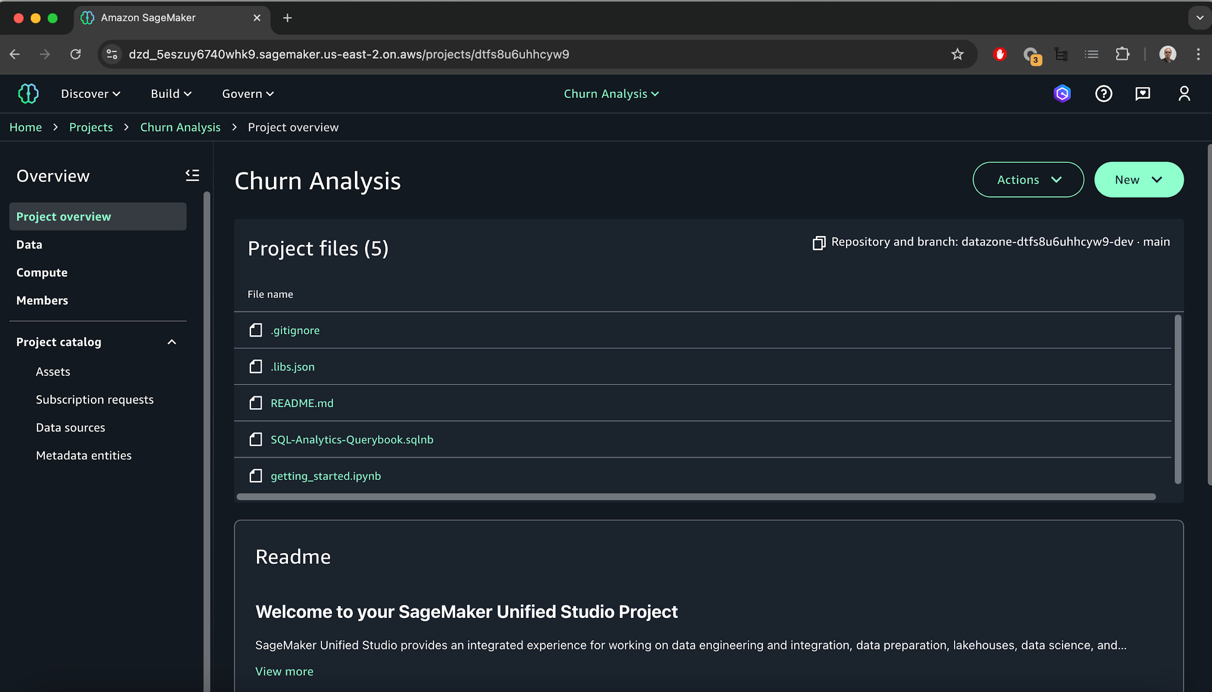
SageMaker Unified Studio (preview)
AN INTEGRATED EXPERIENCE FOR ALL YOUR DATA AND AI
Gen AI assisted experience powered by Amazon Q
See the code, data, ML, and compute for your projects in one view
Work with notebooks, queries, models, and more from familiar AWS tools

Slide 12
Amazon SageMaker Unified Studio (preview)
Healthcare scenario: Accelerating Precision Medicine Research
Data Integration:
Unify genomic datasets, clinical trial results, and patient records using SageMaker Lakehouse, enabling comprehensive access from a single interface.
Collaborative Research: Foster seamless collaboration among bioinformaticians, data scientists, and clinicians through the unified studio environment.
Advanced Analytics and AI: Leverage built-in SQL editor for complex queries and develop ML models to predict drug responses based on genetic profiles.
Generative AI Applications: Create custom AI assistants using Bedrock IDE to help clinicians interpret genomic reports and suggest treatment options.
Enhanced Security: Implement fine-grained access controls and data lineage tracking to protect sensitive patient data and comply with healthcare regulations.
AI-Assisted Development: Utilize Amazon Q Developer to accelerate research tasks, such as generating complex SQL queries and optimizing ML models for genomic data analysis.
Notes:
Scenario: Accelerating Precision Medicine Research
Healthcare organizations looking to revolutionize their approach to data analysis and AI-driven discoveries can greatly reduce time and effort with Amazon SageMaker Unified Studio.
Without SageMaker Unified Studio, researchers would need to navigate multiple tools and platforms, manually integrate diverse data sources, and spend considerable time on data preparation and model development. The unified environment streamlines these processes, potentially cutting research timelines by 30-50%. Collaboration becomes more efficient, with teams able to share insights and resources seamlessly. The AI-assisted development features further accelerate work, allowing researchers to focus more on interpreting results and developing innovative treatments rather than grappling with technical complexities. This efficiency gain could lead to faster breakthroughs in personalized medicine and more rapid translation of research findings into clinical applications.
Use Case:
1. Data Integration: Use SageMaker Lakehouse to unify their vast genomic datasets, clinical trial results, and patient records stored across various systems (S3 data lakes, Redshift data warehouses, and third-party databases). This allows researchers to access and query all relevant data from a single interface.
2. Collaborative Research: The unified studio environment enables interdisciplinary teams of bioinformaticians, data scientists, and clinicians to collaborate seamlessly. They can share notebooks, data pipelines, and ML models within the same platform, accelerating the pace of research.
3. Advanced Analytics: Researchers can leverage the built-in SQL editor to perform complex queries across diverse data sources, enabling them to identify patterns and correlations between genetic markers, treatment outcomes, and patient demographics.
4. AI Model Development: Using SageMaker's ML capabilities, you can develop and train sophisticated models to predict drug responses based on genetic profiles, potentially leading to more effective, personalized treatment plans.
5. Generative AI Applications: With Amazon Bedrock IDE integrated into the Unified Studio, you can build custom generative AI applications. For example, they could create an AI assistant that helps clinicians interpret complex genomic reports and suggest potential treatment options.
6. Enhanced Security and Governance: The built-in governance features ensure that sensitive patient data and proprietary research are protected, with fine-grained access controls and data lineage tracking, helping you to comply with healthcare data regulations.
7. AI-Assisted Development: Researchers can use Amazon Q Developer to accelerate their work, such as generating SQL queries for complex data analysis or getting assistance in building and optimizing ML models for genomic data processing.
By leveraging Amazon SageMaker Unified Studio, you can significantly accelerate the precision medicine research, potentially leading to faster drug discoveries, more accurate disease risk assessments, and ultimately, better patient outcomes in personalized healthcare.

Slide 13
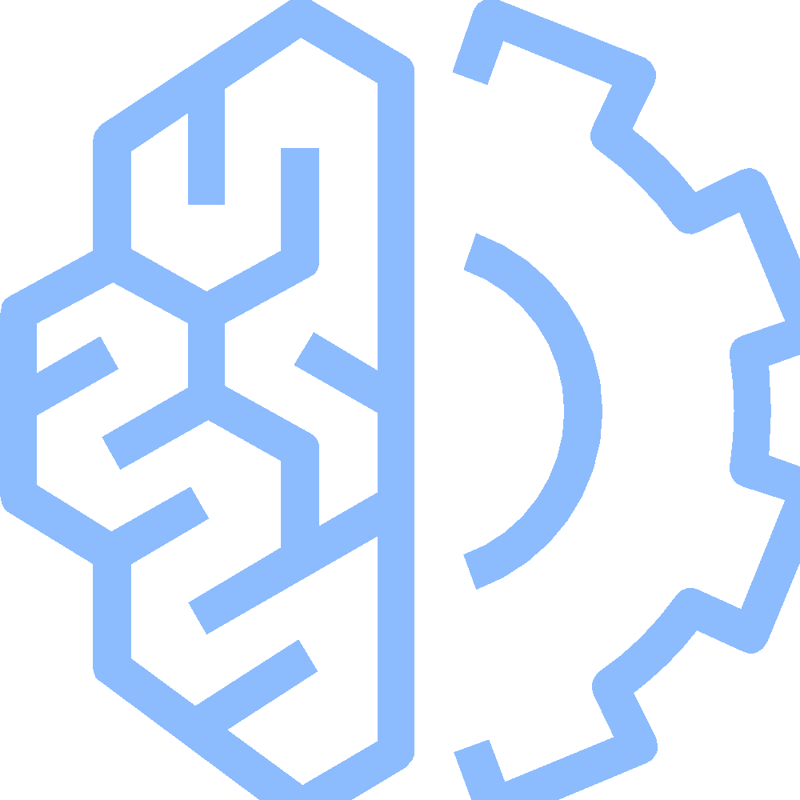
SageMaker AI – Build and Evaluate
SINGLE DEVELOPMENT ENVIRONMENT TO USE ALL YOUR DATA AND TOOLS FOR ANALYTICS AND AI
SageMaker AI
Unified end-to-end ML lifecycle for data prep, model build, training, and hosting
Access team data in shared in your Maxdome domain and project
Build ML models with Integrated Development Environment
Generate code suggestions, detect security and code quality issues with Amazon Q
Managed MLFlow, Model Registry, and interactive Pipelines
Optimized for popular deep learning (DL) frameworks such as TensorFlow, PyTorch, and Hugging Face
Notes:
1/Amazon SageMaker Studio provides all the tools you need to easily train, test, troubleshoot, deploy, and manage FMs at scale and boost productivity of developers while maintaining model performance in production. You can pick different algorithms, including over 20 that are built in and optimized for SageMaker, over 300 pre-built models from popular model zoos available with just a few clicks, and over 15 pre-built solution templates. Inside SageMaker Studio, you can run the models on a small scale to see results and view reports on their performance so you can come up with high-quality working prototypes.
2/The key capabilities for building ML models are:
Fully managed Jupyter Notebooks
Amazon SageMaker offers two options of fully-managed Jupyter Notebooks and the underlying compute resources are fully elastic, so you can easily dial up or down the available resources.
Amazon SageMaker Studio Notebooks are at the center of the SageMaker Studio end-to-end integrated development environment (IDE), where you can collaboratively prepare data, build, train, debug, track, deploy, and monitor your ML models in one place through seamless integrations with AWS services. Studio Notebooks are shared with a single click so colleagues get the same notebook, saved in the same place.
Amazon SageMaker Notebook Instances are stand-alone managed Jupyter Notebook instances that come with built-in deep learning packages and ML frameworks, which you can use as part of your ML workflow to improve your productivity.
Built-in algorithms
Amazon SageMaker also offers over 20 built-in algorithms available in pre-built container images that can be used to quickly train and run inference. Some example algorithms include, DeepAR, K-Means Clustering, Linear Learn, K-Nearest Neighbor, and BlazingText.
AI-powered developer tools
Boost ML development productivity with AI-powered developer tools in the development environment. Generate, debug, and explain the source code with Amazon CodeWhisperer and conduct security and code quality scans with Amazon CodeGuru.
Pre-built solutions and open-source models
Amazon SageMaker JumpStart, which is a ML hub offering models, algorithms, and prebuilt ML solutions. SageMaker JumpStart offers hundreds of ready-to-use FMs from various model providers, including a growing list of best performing publicly available FMs such as Falcon-40B, Stable Diffusion, OpenLLaMA, and Flan-T5/UL2. Customers have breadth of choice with access to FMs through environments they already use, including SageMaker Studio, the SageMaker SDK, and the Amazon SageMaker console.
Optimized for major frameworks
Amazon SageMaker is optimized for many popular deep learning frameworks such as TensorFlow, PyTorch, and Hugging Face. Frameworks are always up-to-date with the latest version, and are optimized for performance on AWS. You don’t need to manually setup these frameworks and can use them within the built-in containers.

Slide 14
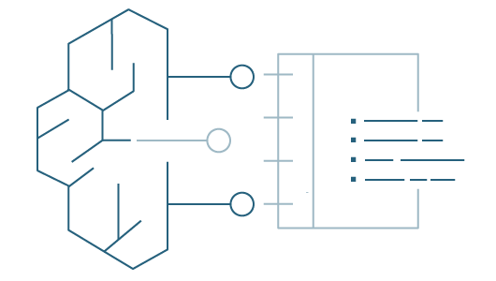

Amazon SageMaker Studio Lab
A JUPYTER NOTEBOOK SERVICE TO HELP CUSTOMERS MASTER THEIR SKILLS
Amazon SageMaker Studio Lab
Create an account with an email address – free
A no-charge, no-configuration service that enable data scientists to learn and experiment with machine learning
No setup or configuration required
15 GBs to save your work projects.
As many compute sessions as you need –
CPU (12 hrs)/GPU (4 hrs)
Access any notebook on GitHub
Migrate to SageMaker Studio when ready
https://studiolab.sagemaker.aws/

Slide 15


Amazon Bedrock
FOUNDATION
MODEL
CUSTOMIZATIONS
YOUR DATA
Fine tuning
Retrieval Augmented Generation (RAG)
Continued Pre-training
Notes:
Amazon Bedrock gives you all the purpose-built capabilities you need to customize Gen AI applications with your own data.
With a few clicks you can go from generic applications to ones that are specific and tailored.
1) One important technique is fine-tuning, in which you point the models to examples of data in S3 that you have labeled to provide context. For example, you might point to proposals you have labeled as “strong.” In this way, the model learns from your data what matters to you.
Then, Bedrock makes a copy of the base model, trains it, and creates a private, fine-tuned model so you get tailored responses.
Fine-tuning is available for Amazon Titan Text Lite and Express. And today, it is generally available for Cohere Command Lite, and Meta Llama 2.
And fine-tuning for Anthropic Claude models is coming soon.
2) A second technique for tailoring FMs for your business is Retrieval Augmented Generation or RAG.
RAG allows you to customize a model’s responses when you want the model to consider new knowledge or up-to-date info.
Bedrock does this by calling and bringing back your own data from multiple sources, including document repositories, databases, and APIs. For example, the model might use RAG to retrieve search results from Amazon Opensearch Service or documents from S3.
We introduced a RAG capability called Knowledge Bases, that connects FMs to your proprietary data sources to supplement your prompts with more information. And today Knowledge Bases is now Generally Available.
3) A third way you can customize models in Bedrock is with continued pre-training. This is a technique that uses large volumes of unlabeled data – like the raw text of internal reports, financial plans, or research results – to improve the FMs knowledge and reasoning capabilities of your own specific domain.
All of these techniques are powerful tools in making Gen AI targeted and useful for your business. And Bedrock makes it easy to combine these techniques together.
A great example of a customer using Bedrock to customize their generative AI applications is Delta Airlines.
But at the end of the day you’ll want FMs to do more than just provide useful and targeted information. Ultimately you will want…

Slide 16







Amazon Bedrock
Effective reasoning & rapid analysis for long context windows
Frontier multimodal intelligence at low-latency, Agent & RAG Applications, high-quality image & video generation
Advanced reasoning & coding capabilities, including computer use skills
Multimodal search & advanced retrieval powering multilingual knowledge agents
High-quality video generation from text & images
Advanced image & language reasoning
Knowledge summarization, expert agents, & code completion
Software engineering AI for large enterprises
High-quality AI image generation, easily deployable at scale
COMMAND
EMBED
RERANK
JAMBA
AMAZON NOVA
MISTRAL
MIXTRAL
MALIBU
POINT
STABLE DIFFUSION
STABLE IMAGE
CLAUDE
LUMA RAY 2
LLAMA

Slide 17
Hands-on Demo
Amazon SageMaker

Slide 18
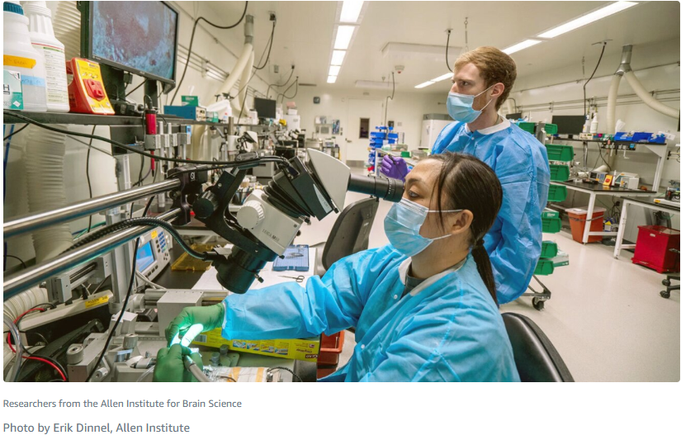
[PLACEHOLDER – Case Studies]

